Slide 1
4 Bit parallel adder/ subtractor using IC7483
Prepared By : jahangir alam

Slide 2
Parallel Adder:
Parallel Adder – A single full adder performs the addition of two one bit numbers and an input carry. But a Parallel Adder is a digital circuit capable of finding the arithmetic sum of two binary numbers that is greater than one bit in length by operating on corresponding pairs of bits in parallel. It consists of full adders connected in a chain where the output carry from each full adder is connected to the carry input of the next higher order full adder in the chain. A n bit parallel adder requires n full adders to perform the operation. So for the two-bit number, two adders are needed while for four bit number, four adders are needed and so on. Parallel adders normally incorporate carry lookahead logic to ensure that carry propagation between subsequent stages of addition does not limit addition speed.

Slide 3
N-bit Parallel Adder:

Slide 5
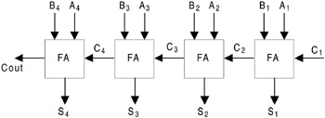
FOUR-BIT BINARY PARALLEL ADDER
In the preceding session, we discussed how two binary bits can be added and the addition of two binary bits with a carry. In practical situations it is required to add two data each containing more than one bit. Two binary numbers each of n bits can be added by means of a full adder circuit. Consider the example that two 4-bit binary numbers B ₄B ₃B ₂B ₁ and A ₄A ₃A ₂A ₁ are to be added with a carry input C ₁. This can be done by cascading four full adder circuits as shown in Figure The least significant bits A ₁, B ₁, and C ₁ are added to the produce sum output S ₁ and carry output C ₂. Carry output C ₂ is then added to the next significant bits A ₂ and B ₂ producing sum output S ₂ and carry output C ₃. C ₃ is then added to A ₃ and B ₃ and so on. Thus finally producing the four-bit sum output S ₄S ₃S ₂S ₁ and final carry output Cout. Such type of four-bit binary adder is commercially available in an IC package.

Slide 6
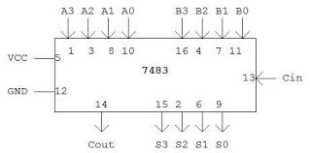
Diagram:

Slide 7
Procedure:
1. Apply the inputs to A0 to A3 and B0 to B3.
2. Connect Cin to the Ground for addition..
3. Check the output sum on the S0 to S3 and also C4.
4. For subtraction connect Cin to Vcc, Apply the B input through NOT gate, which gives the complement of B.
5. The truth table of adder and Subtractor are noted down.

Slide 8
4 bit Parallel Subtractor:

Slide 9
Full Subtractor Using Not Gate

Slide 10
Truth Table:Adder/Subtractor
A3 | A2 | A1 | A0 | B3 | B2 | B1 | B0 | C4 | S3 | S2 | S1 | S0

Slide 11
Thank You…

